Slide 1





Welcome to the Webinar Offered by: National Microelectronics Security Training (MEST) Center
Sponsors:
Notes:
Welcome to the Microelectronics…webinar titled this this
Until 12:03 or send to instructor to have them keep slide for the first 5-8 minutes MEST Logo title and logo name
Uf logo and OSU logo, sponsors AFRL and Nimbis.

Slide 2

Introduction to Systems-on-Chip Multi-Processor Integration
Abigail Butka, Kawser Ahmed Muhammed, Wade Fortney, Christophe Bobda
National Micro Electronics Security Training (MEST) Center

Slide 3
Agenda
System-on-Chip Refresher
Multi-Processor Systems
Why Is It Important for Processors to Communicate?
How Do Multiple Processors Communicate With Each Other?
How Do Processors Communicate Using a Mailbox?
Case Study and Tutorial
Conclusion
National Micro Electronics Security Training (MEST) Center

Slide 4
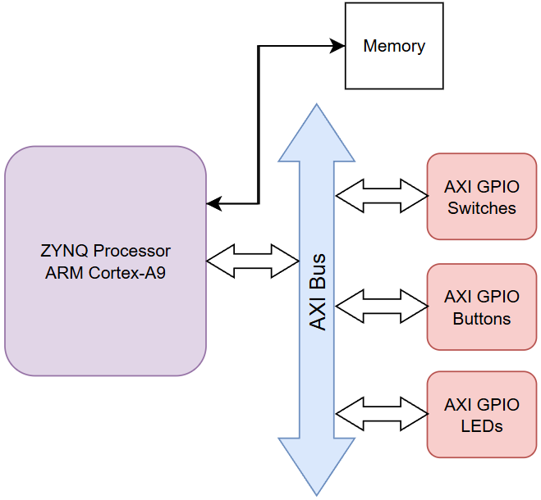
SoC- Architecture
National Micro Electronics Security Training (MEST) Center

Slide 5
Multi-Processor Systems

Slide 6
Why Is It Important for Processors to Communicate?
Parallel processing
Allows processors to perform multiple tasks simultaneously to boost performance
Processor specializations
Each processor can be specialized for a specific function, such as high-speed calculations, or high-performance calculations
Power efficiency
Distributing tasks allows for processors to operate at lower power and frequency
National Micro Electronics Security Training (MEST) Center

Slide 7
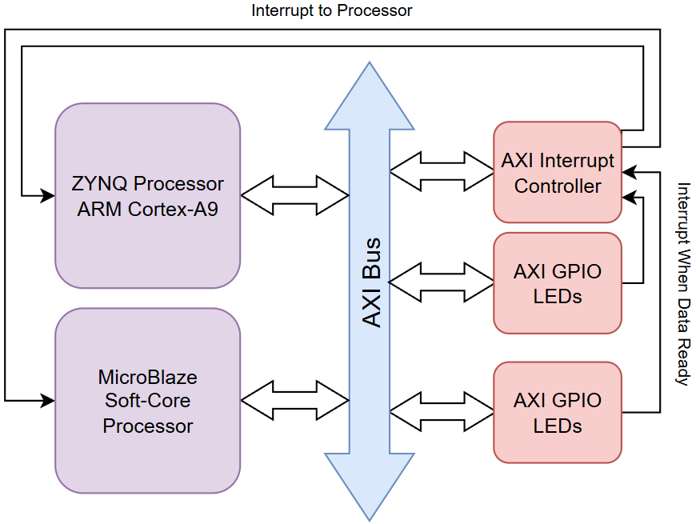
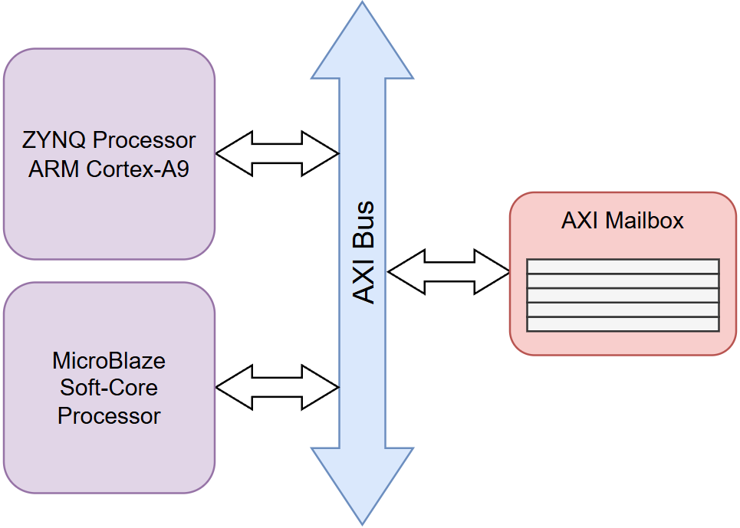
How Do Multiple Processors Communicate With Each Other?
Two main options in an SoC
Indirect communication. Processors read and write data to IPs in the system.
With interrupts
When data is ready, the processor A, or an IP, interrupts processor B to let it know to read the data
Without interrupts
Processor A writes data to an IP, and Processor B waits for the IP’s ready signal
Direct communication through a mailbox
National Micro Electronics Security Training (MEST) Center

Slide 8
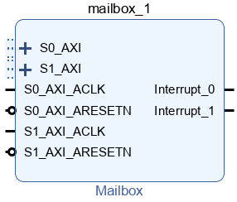
How Do Processors Communicate Using a Mailbox?
AXI Mailbox
Allows communication between only two processors
Stores data in memory using a FIFO (First-In, First-Out)
For the MicroBlaze to send data to the ZYNQ processor…
The MicroBlaze will write data to the Mailbox
XMbox_WriteBlocking(Mailbox_Address, data, num_bytes);
This command is blocked if the mailbox is full
The writing processor will wait for the mailbox to have space before continuing
The Mailbox receives this data and stores it in the FIFO
Meanwhile, the ZYNQ is waiting for data to enter the Mailbox
XMbox_ReadBlocking(Mailbox_Address, data, num_bytes);
Similarly, the reading processor will wait for the mailbox to have a message before continuing
When the MicroBlaze is done writing to the Mailbox, the Mailbox can respond to the ZYNQ’s data read request.
National Micro Electronics Security Training (MEST) Center

Slide 9
What Processors Can We Use in Systems-on-Chip?
Hard processors
Many Systems-on-Chip and FPGAs come with “hard” processors built into the fabric
Xilinx Zynq - ARM Cortex-A9
Xilinx Zynq Ultrascale+ - ARM Cortex A53 and Cortex-R5
Intel Stratix 10 – ARM Cortex-A53
Soft processors
When SoCs and FPGAs do not have a hard processor, or require more processors, “soft-core” processors can be used.
These are microprocessors made up of code that will be implemented into the fabric
Xilinx MicroBlaze
Intel Nios II and NIOS V
RISC-V
National Micro Electronics Security Training (MEST) Center

Slide 10
Case Study and Tutorial

